Slide 1
Same Data – Different Analysis
BonaRes R-Group
(Marcus Schmidt, Bernd Berauer)

Slide 2
Sample descriptives
Geographic & Topographic
Vegetation
Summarise:
Exotic / Native
Plant Functional Type
Life Form/Length
Eucalyptus
Climate & Environment

Slide 3
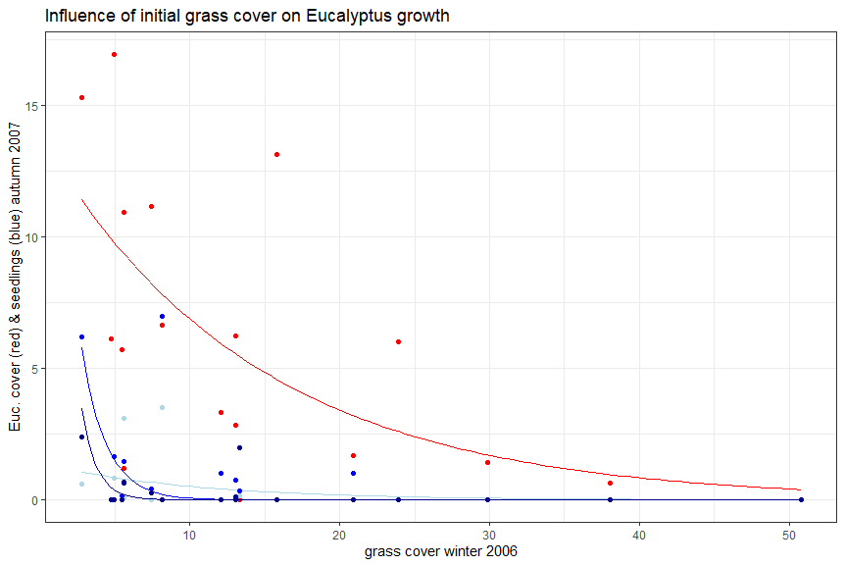
Design
Eucalyptus ~ grass, random = ~1| (Property / Quadrat)
Different Properties within different quadrats (Blocking by quadrat?) -lme

Slide 4
2006
2007
Kunst

Slide 5
analysis
1st effect of grass on eucalyptus (Marcus)
  P-werte, model estimations/Güteparameter
Other drivers influencing eucalyptus cover
  Stepwise regression (full model, expert based)
  Variance partitioning? (get done to here and then discuss expert knowledge)
Factors influencing grass cover (similar as above)
3rd mixed model führt alles zusammen

Slide 6
The cocnept
Step 1 [Stepwise regression to find incluencing factors] Bernd
Step 2 [Linear mixed effects model to predict Euc cover (and seedlings) from Grass cover & influcing factors] Bernd & Marcus
Step 3 [Visualize Euc cover (and seedlings) depending on grass cover] Marcus

Slide 7
Eucalyptus establishment
Full-Model (add1 oder substract1) to improve model fit. „Stepwise regression“
  Euc ~ geographic * climatic * vegetation
  http://www.sthda.com/english/articles/37-model-selection-essentials-in-r/154-stepwise-regression-essentials-in-r/
Welche variablen machen am meisten sinn?
Grenze zu „Wald“ anhand von Euc-cover. Vlt unterscheidliche effekte
[The Food and Agriculture Organization (FAO) of the United Nations defines forest as land spanning more than 0.5 hectares with trees higher than 5 m and a canopy cover of more than 10%, or trees that are able to reach these thresholds in situ]

